Slide 1

PANTONE® COLOUR OF THE YEAR 2022

Slide 2

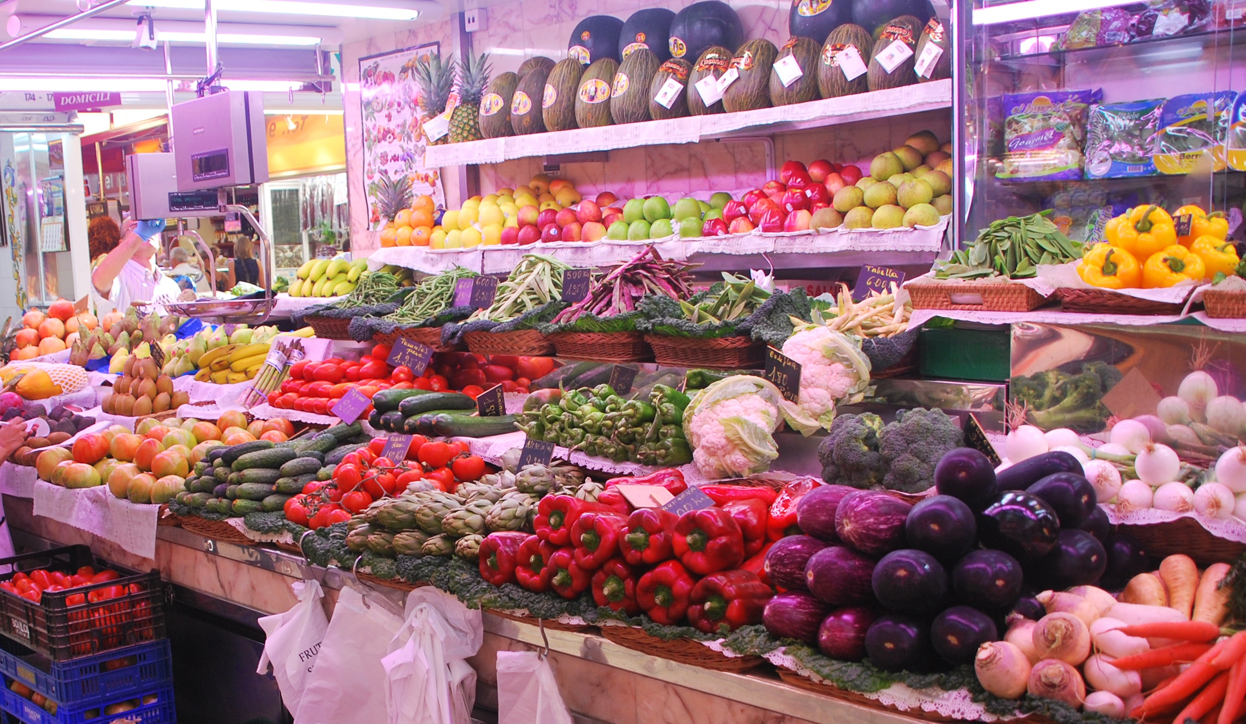
FOOD TREND UK
MY PRESENTATION IS BASED ON FOOD TRENDS IN THE UK.
DATA SOURCES : UK GOVERNMENT WEBSITE ON THE DEPARTMENT FOR ENVIRONMENT, FOOD AND RURAL AFFAIRS(DEFRA) BASED ON FOOD AND FARMING.
MY PURPOSE IS TO DEMONSTRATE TRENDS BASED ON THIS DATA TO FIND THE LEVEL OF CONSUMPTION OF DRIED RICE BETWEEN THE AGES OF 30 AND OVER.

Slide 3
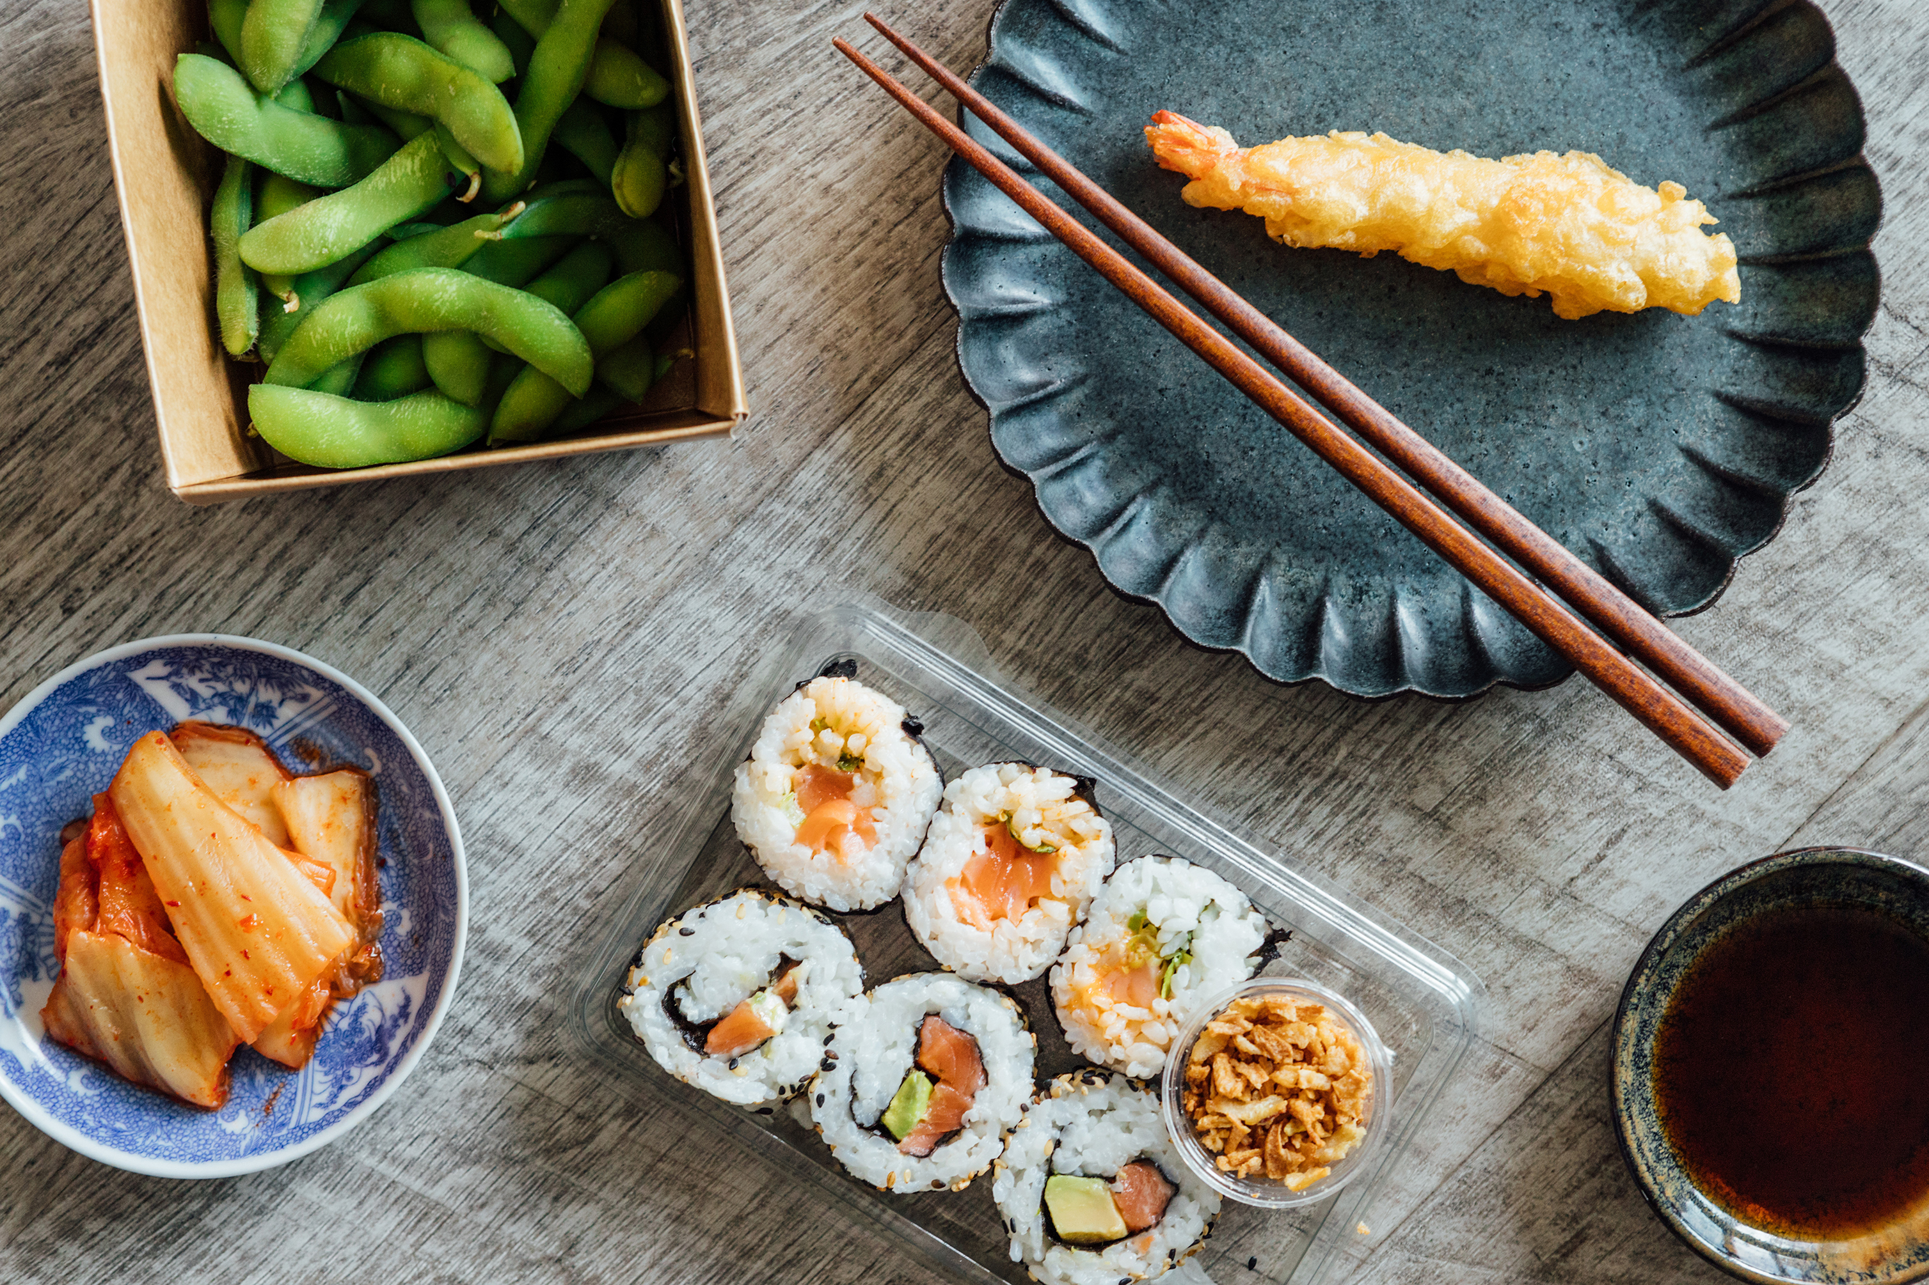

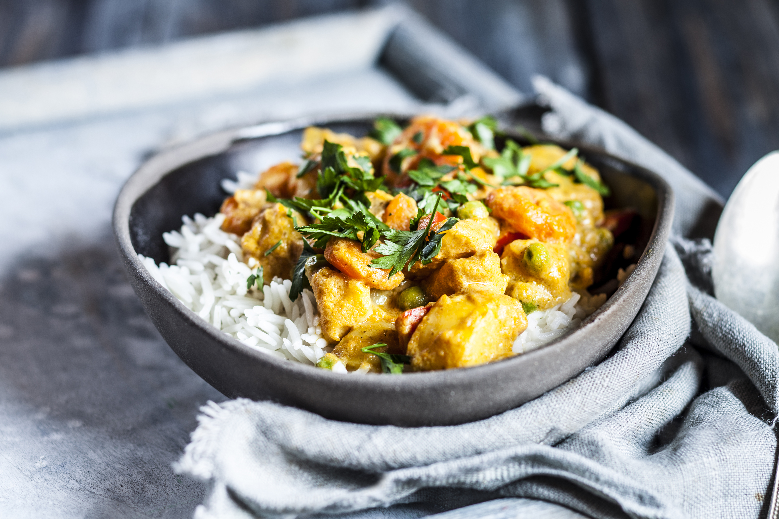



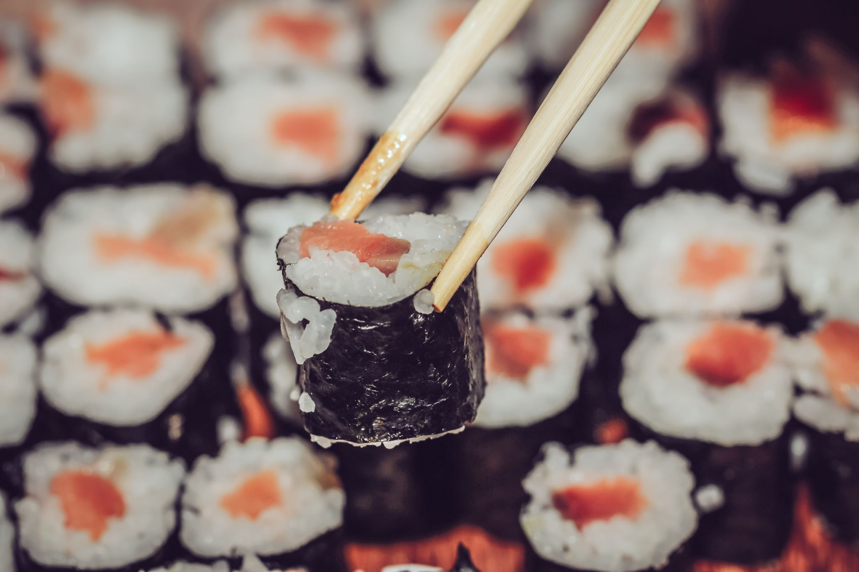

FOOD TREND

Slide 4

FOOD TRENDS
AGE GROUPS: 30 AND ABOVE
DATASETS: 3
DATAOUTPUTS: 3

Slide 5
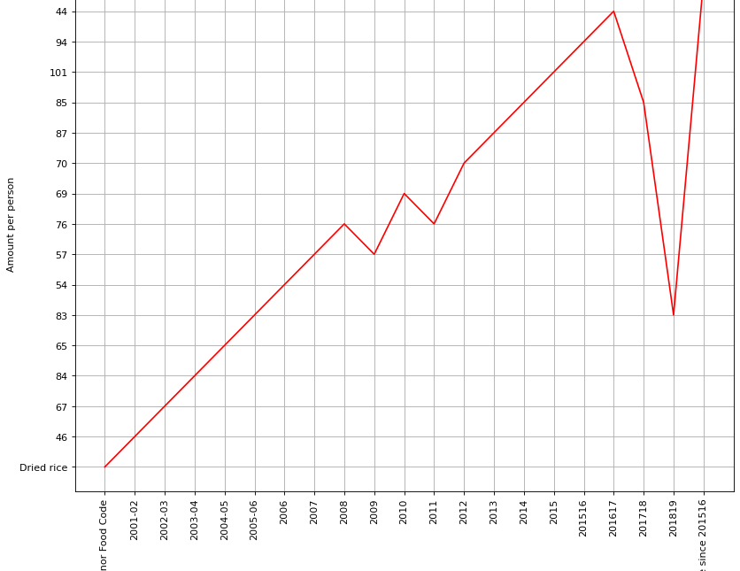
FOOD TREND UK
We can see the huge drop in the consumption of dried rice between 2016/17 and suddenly went back up again between 2017/18
The year 201617 has the lowest consumption of dried rice, while 2015 and 201516 has the highest consumption of dried rice.

Slide 6
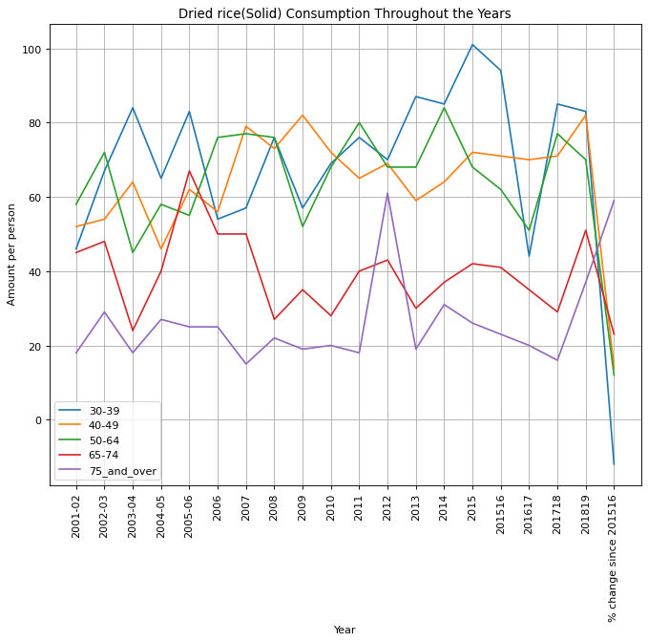
FOOD TREND UK
This data provides the consumption of dried rice between all ages, and from the subplot provided, ages 30-39 have the highest intake of dried rice and especially during 2015 which reflects on the above subplot of the highest consumption between 2015 and also 201516, Ages 75_and_over have the lowest consumption of dried rice between all ages.

Slide 7
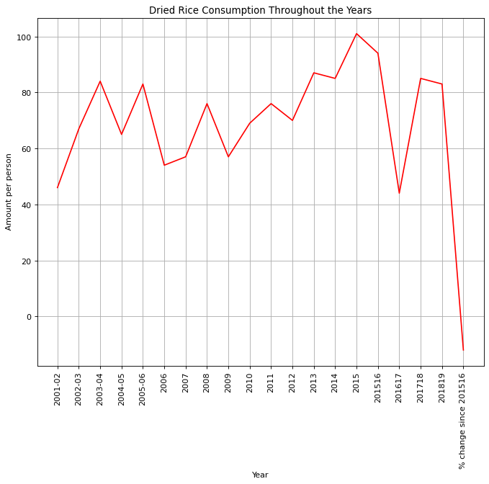

Slide 8
CONCLUSION
There is a lot of differences between the different age groups and over a long period of time, I noticed a huge drop in the consumption of dried rice for ages 30-39, from 2016-17, but suddenly picked back up greatly between 2017-18. Ages 40-49 does not have that very much difference in the consumption from the data shown, another noticeable point are for the Ages 75 and above, I noticed the consumed less over the Years but more was consumed during, 2012 and, also between 2018-19.

